Slide 1
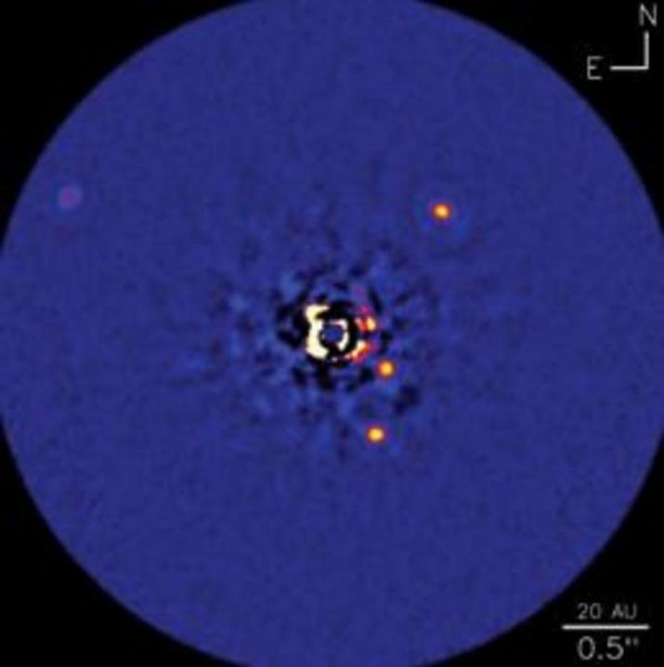



High Resolution Spectra of Exoplanets
HR8799b
HR8799c
Gabriel Basadre
Mentor: Travis Barman, Lunar and Planetary Lab
Space Grant Symposium, April 16, 2016
Image credit: NRC-HIA, C. Marois & Keck Observatory
Notes:
Exoplanets directly imaged at the Keck II telescope

Slide 2
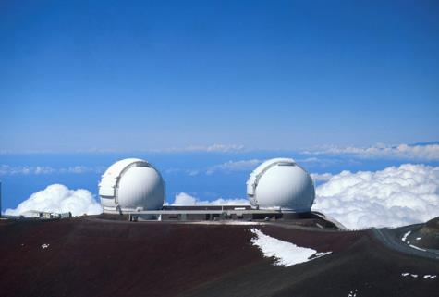



Observations / Data
Observations taken at the Keck II telescope in Mauna Kea, Hawaii
August 8 – 9, 2012; October 24-26, 2012
20 min exposures
Some observations impacted by weather
NIRSPEC (Near-Infrared Spectrograph)
Provides R ~ 25,000 spectra
Single-slit
Cross-Dispersed
Adaptive Optics
Corrects for unstable atmosphere
Reduces the scattering of starlight
Image of twin Keck Telescopes from http://www.jpl.nasa.gov/news/news.php?feature=585
Notes:
Observations made at Keck using NIRSPEC and AO
Some observations impacted by weather
Why this telescope?
Needed a large telescope in the northern hemisphere with NIRSPEC and AO, so choices limited

Slide 3
Motivation (Planet Formation)
Studying the youngest planets helps to better understand how planets form
HR8799 (Star):
~ 33 Myrs old
Contains four gas giants
HR8799 b and c (Planets):
Gas giants, more massive than Jupiter
Hotter than Jupiter
Bright in the infrared
Notes:
Planet formation
Study youngest planets
HR8799 billions of years younger than our star
Planets hot, bright

Slide 4
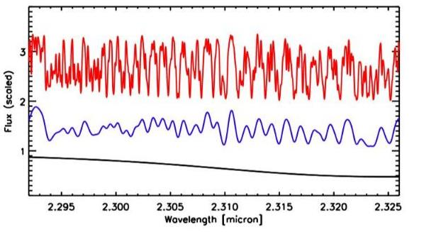
Motivation (High-Resolution Spectroscopy): Provides Estimates of Rotational and Orbital Velocity
High, Medium, and Low Resolution Spectra (HR8799)
Blue-Shift
Red-Shift
Line Width
Higher Spectral Resolution
Model Spectra at R ~ 100, 4000, 25,000
Notes:
Well resolved lines make it easier to measure smaller shifts (Orbital Velocity)
Easier to detect line broadening (Rotational Velocity)

Slide 5
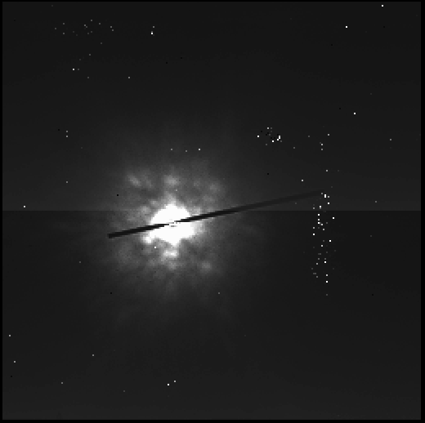
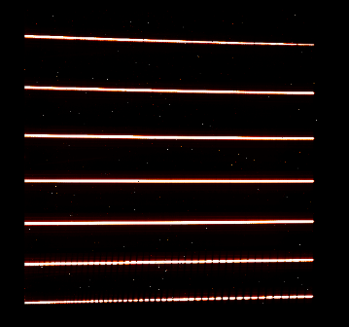
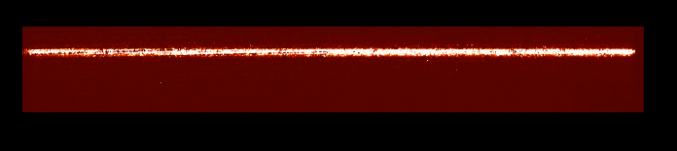
Objective: Extract the Spectra of HR8799 b and c
Scam image 4.3” x 4.3”
Slit placed on HR8799c
Raw Image from
NIRSPEC Spectrograph
Obstacles:
Scattered Star Light (Speckles)
Locating faint planet trace
See cutout of order 33 below
Low signal-to-noise data
Order 33
Faint Planet
Bright Star + Speckles
Star’s Trace
Planet’s Trace
(Somewhere)
2.29
Wavelength (Microns)
2.33
Dark-Subtracted; Flat-Fielded; Spatially and Spectrally Rectified
Notes:
Extract hi res spectra of HR8799 b and c
Why is this difficult?
Problem 1: requiring high-contrast imaging for slit placement (Bright star, faint planet)
Problem 2: Scattered starlight, bright star (images)
Problem 3: Data reduction packages bad for low signal to noise (Star Primary noise source)

Slide 6
Methods / Techniques
The REDSPEC data reduction package is a set of procedures written in IDL
Slow, relying on GUIs and visual inspection to isolate the trace of the target
Automate the process by removing GUIs
Find the trace using cross-correlation
Cross-correlation compares two spectra and quantifies their “likeness" (how similar the two spectra are or are not)
Notes:
Modifying data reduction package redspec
What redspec is:
Why it doesn’t work for us
How we’re improving it
What cross correlation is

Slide 7
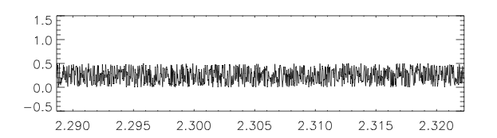
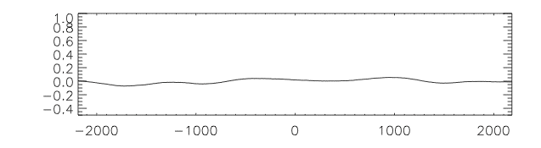
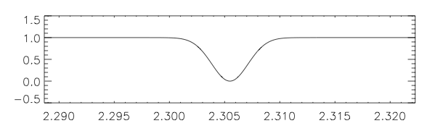
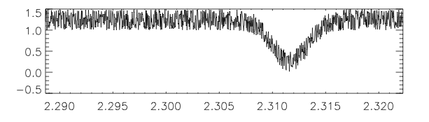
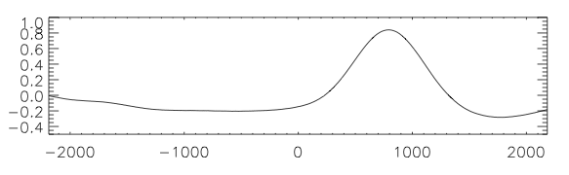
Cross-Correlation Example (The “Likeness” of Two Spectra)
Randomly Generated Noise
Noise Cross-Correlated with Template
Correlation
Template Spectrum
Not Very Correlated Anywhere
Flux (Normalized)
Highly Correlated at a Shifted Velocity
Template Spectrum + Noise & Shifted
Spectrum Cross-Correlated with Template
Correlation
Wavelength (Microns)
Velocity
Notes:
Two “spectra” and a Template
Noise correlation not correlated much anywhere
Bottom spectrum shares Gaussian shape, shifted slightly in velocity space

Slide 8
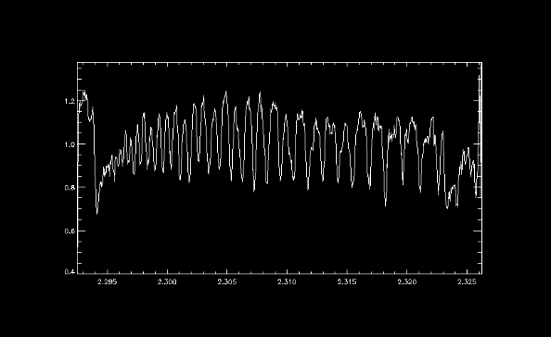
The Template: Brown Dwarf Spectrum
We expect HR8799 b & c to have similar features
We do not know the location of the spectrum, so…
Extract spectra from each row of the order
Cross-Correlate each spectrum against the template, producing a mapping of the cross-correlation
Brown Dwarf 2MASS_07464A
Spectrum at Brown Dwarf’s Trace on Order 33
Flux (Normalized)
Wavelength (microns)
Konopacky et al. (2012)
Notes:
What: our template Brown Dwarf
Why: similar features in order 33
How: the code does this, what it produces

Slide 9
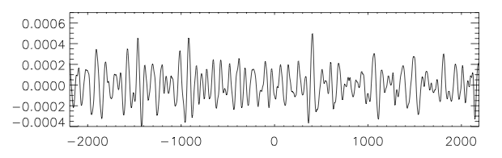
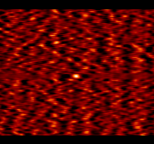
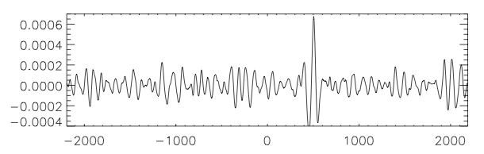
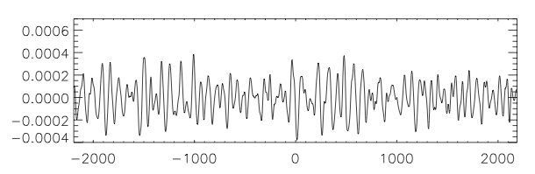
Test: Inject the Template Spectrum at Row 69 of Random Noise
Cross-Correlation at Row 108 (Medium Correlation)
Cross-Correlation Mapping:
“Fake Planet” + Noise Correlated with Template
Cross-Correlation at Row 69 (High Correlation)
Fake Planet
Correlation
Cross-Correlation at Row 52 (Low Correlation)
Each Row is a Cross-Correlation with the Template
Bright Spots Indicate Higher Correlation
Velocity
Notes:
What the test is
Explain the mapping
Show that the fake planet can be confirmed to be where we put it
Show that other bright spots are not necessarily highly correlated

Slide 10
Project Status and Future Work
Project Status:
Further Testing by injecting “Fake Planet” Spectra
Characterize the sensitivity of the data
Working to detect the spectra of HR8799 b & c in our data
Design future observing proposals
Future Work:
Using the higher resolution spectra from the planets, we can estimate:
Radial velocity
Rotational velocity
Gravity
Presence of new molecules
Planet Masses
Notes:
What we’re doing now
What we’ll be doing when we’ve completed the project

Slide 11
Acknowledgements
NASA Space Grant
University of Arizona
NExSci for time allocated on the Keck Telescope
LPL, including Sarah Peacock, Josh Lothringer, and Ian Crossfield for interesting discussions
Additional collaborators on this project include: Quinn Konopacky (UCSD), Christian Marois (HIA/Victoria), Bruce Macintosh (Stanford), Raphaël Galicher (Obs de Paris)
The data presented herein were obtained at the W.M. Keck Observatory, which is operated as a scientific partnership among the California Institute of Technology, the University of California and the National Aeronautics and Space Administration. The Observatory was made possible by the generous financial support of the W.M. Keck Foundation.
We wish to recognize and acknowledge the very significant cultural role and reverence that the summit of Mauna Kea has always had within the indigenous Hawaiian community. We are most fortunate to have the opportunity to conduct observations from this mountain

Slide 12
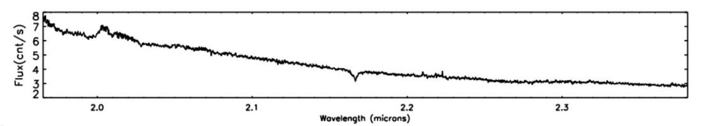
HR8799
HR8799b
HR8799c
Spectral Type | A5V
Mass (M_{SUN}) | 1.516^{+0.038}_{-0.024}
log Luminosity (L_{SUN}) | 5.05 +- 0.29
Distance (pc) | 39.4 +- 1.09
Age (Myr) | 33⁺⁷_{-13.2}
Effective Temperature (K) | 7193 +- 87
Mass (M_{JUP}) | 7 (5-11) | 10 (7-13)
Orbital Period (years) | ~ 460 | ~ 190
log Gravity (cgs) | 3.5 | 3.5
Effective Temp (K) | 1000 | 1200
Marois et al. (2008)
Baines et al. (2012)
Medium-Resolution Stellar Spectrum (Osiris)
Order 33
Notes:
Why we’re using this planetary system.
Star is very young
Planets’ orbital periods are very long, making it difficult to use the radial velocity technique, which requires a full period
Planets are gas giants, hotter than Jupiter, making them very bright
CO contains the most features in order 33, and the star has very few features in order 33
HR8799 is rapidly rotating, causing broadening of spectral lines
Planet orbital periods are very long
This makes the inference of the planets very difficult using the radial velocity technique, so direct imaging was used intead

